Slide 1


Slide 2
Course Title: Programming Fundamentals
Course Code: CSC103
Credit Hours: 04 (3+1)
Pre-requisite: None

Slide 3
books
Textbook:
C++ How to Programme, Paul Deitel and Harvey Deitel, Prentice Hall, 9th Edition (February 2013)
Reference Books:
Turbo C by Robert Lafore, 1st Edition (1988)
Introduction to Computers 6th International Edition, by Peter Norton

Slide 4
Recap:
Understanding basic concept of loops
Why we need loops
Advantages of loops
While and do while loop

Slide 5
Objective:
Understanding for loops
Nested for loops
Nested while loops
Continue statement
Goto statement

Slide 6
For Loop
A loop is used for executing a block of statements repeatedly until a particular condition is satisfied. For example, when you are displaying number from 1 to 100 or in backward direction say from 100 to 1, you may want set the value of a variable to 1 or 100 and display it 100 times, increasing/decreasing its value by 1 on each loop iteration.
Basic syntax is as below:
for(initialization; condition ; increment/decrement)
{
statement;
}

Slide 7
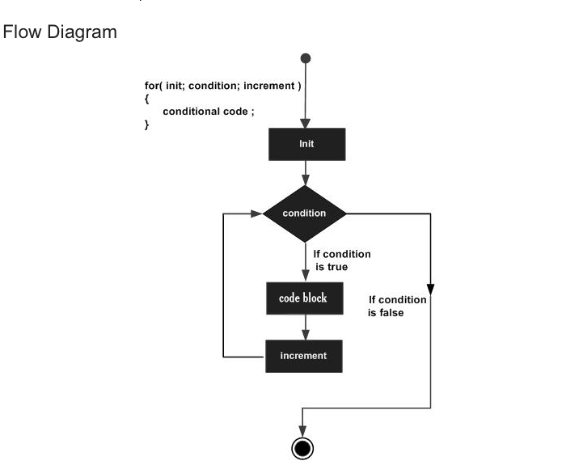
/decrement

Slide 8
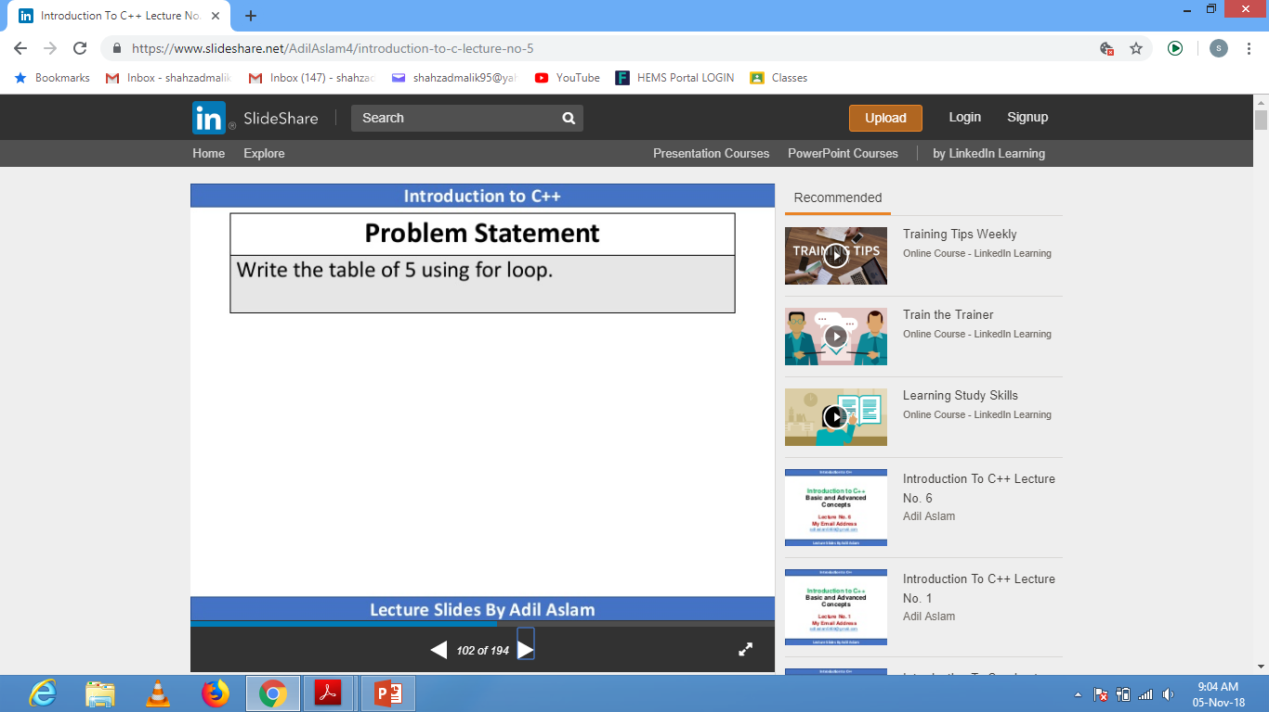

Slide 9
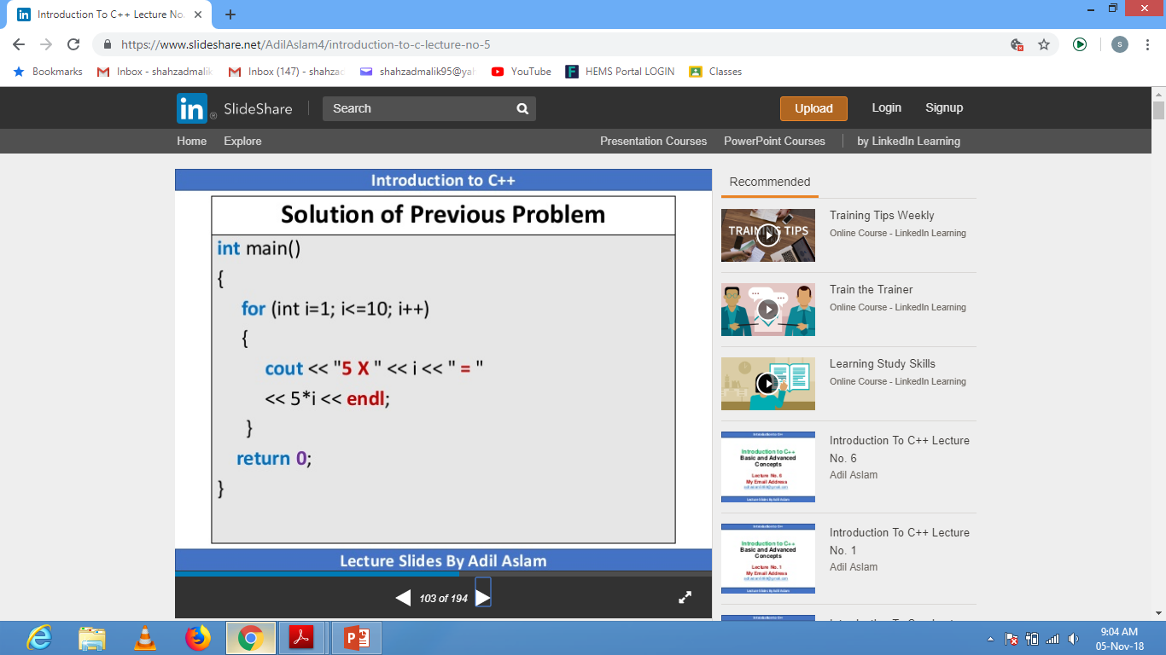

Slide 10
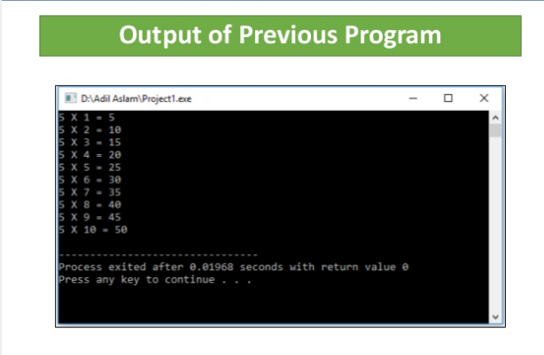

Slide 11
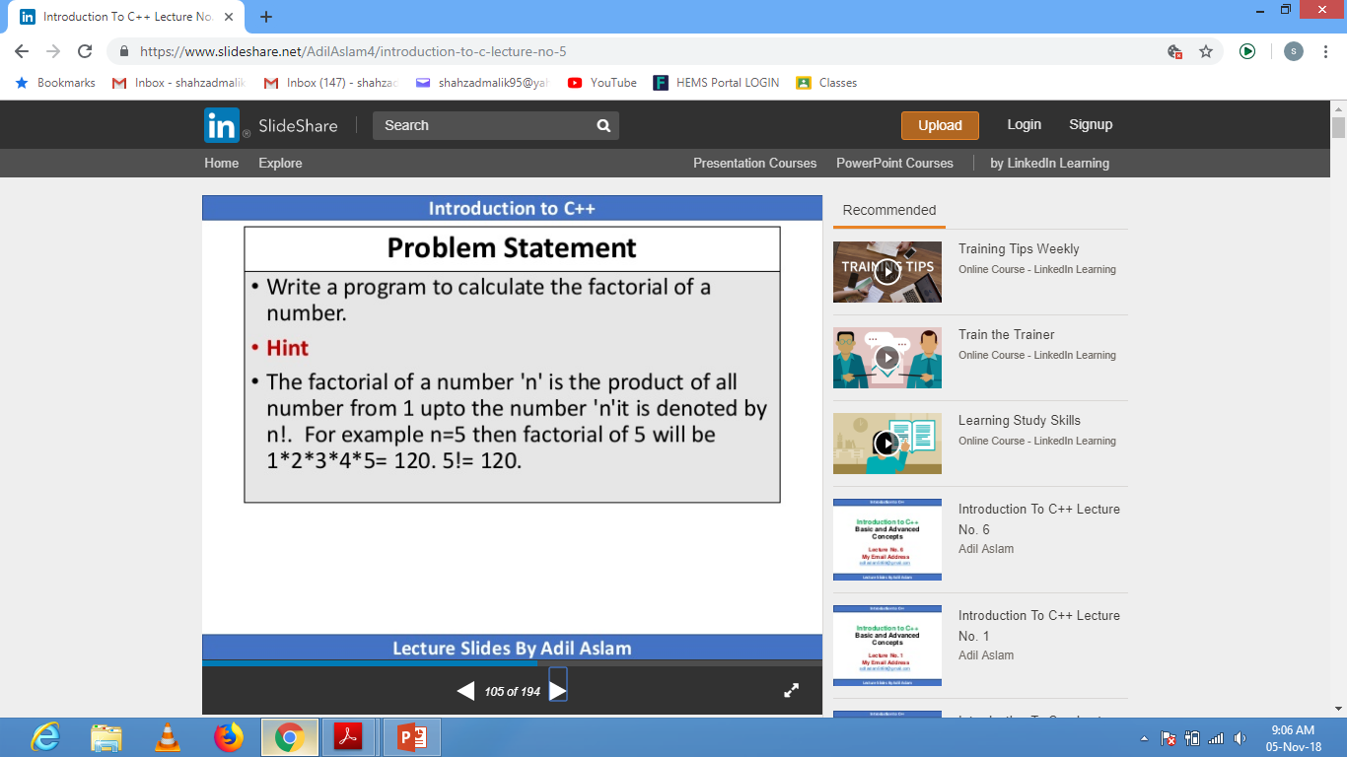

Slide 12
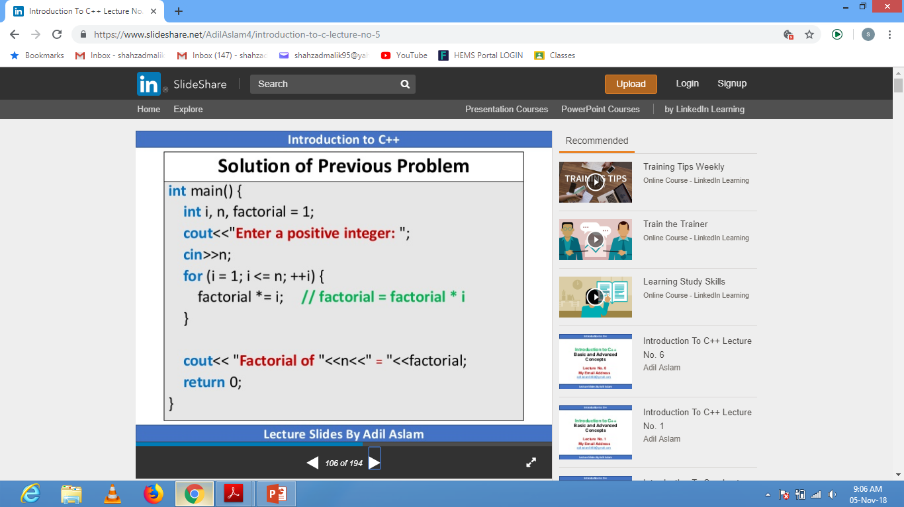

Slide 13
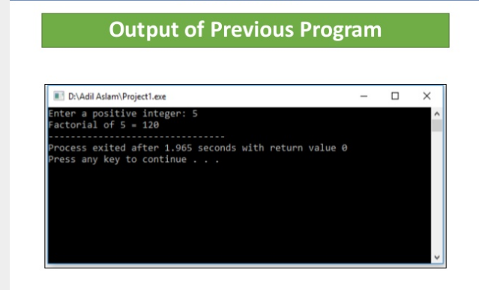

Slide 14
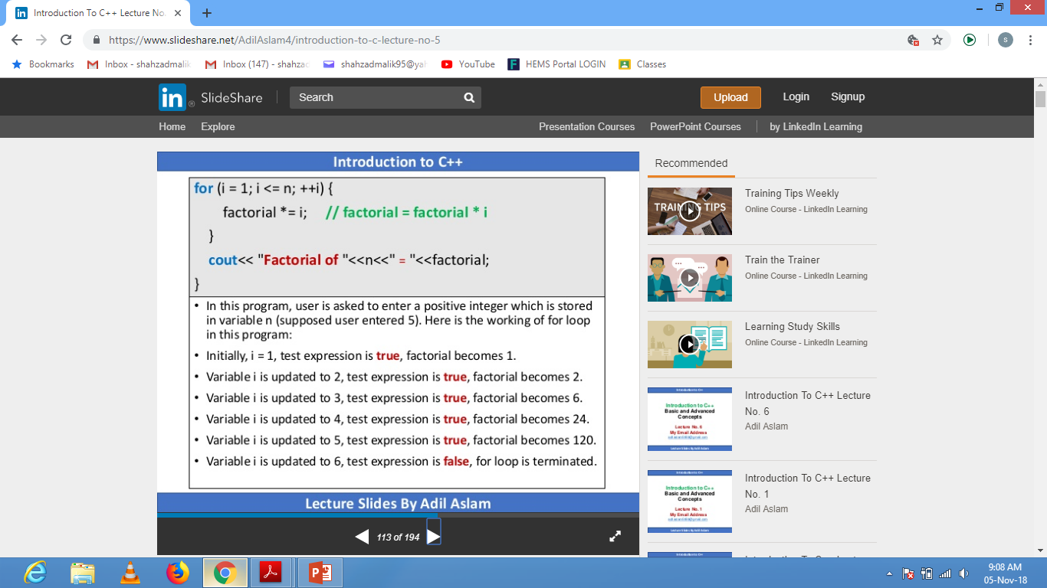

Slide 15
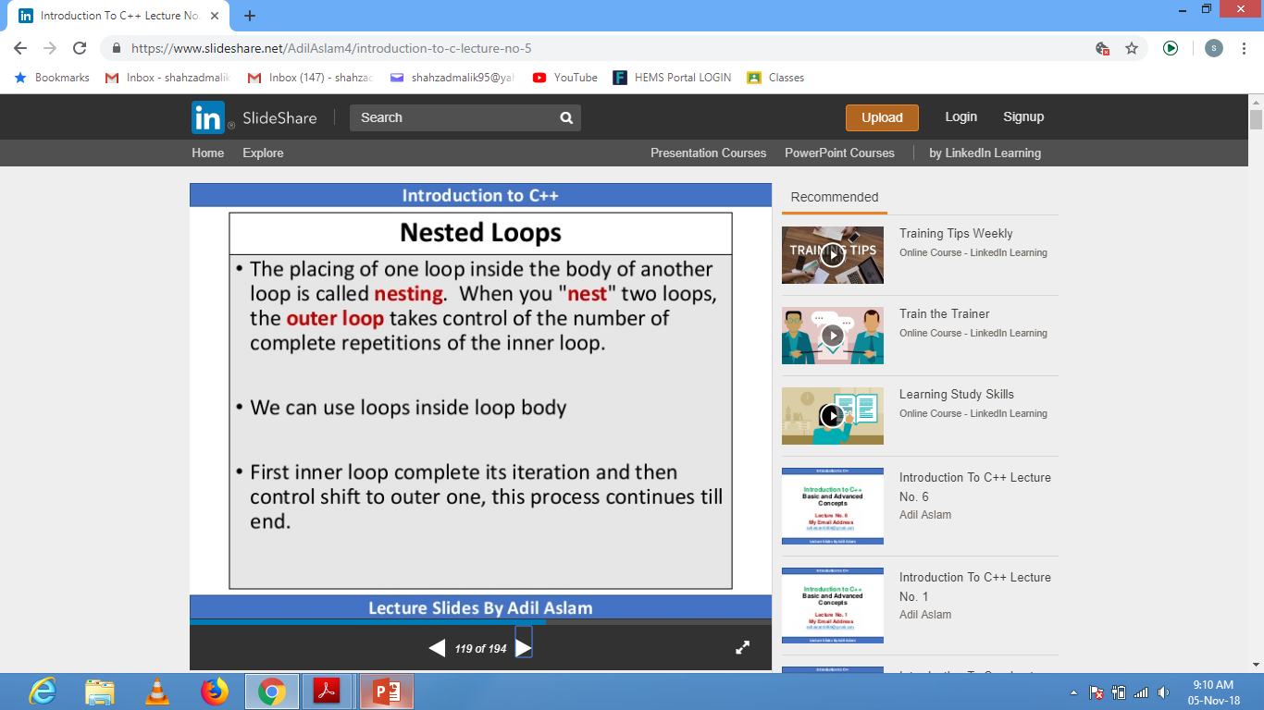

Slide 16
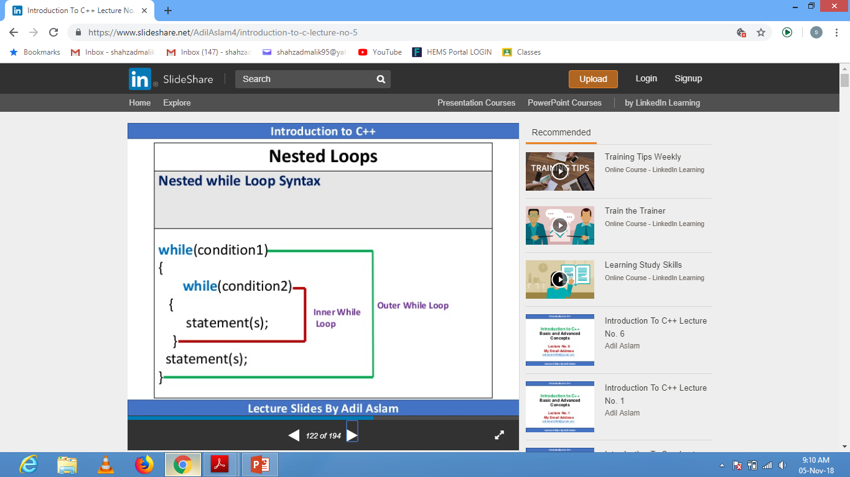

Slide 17
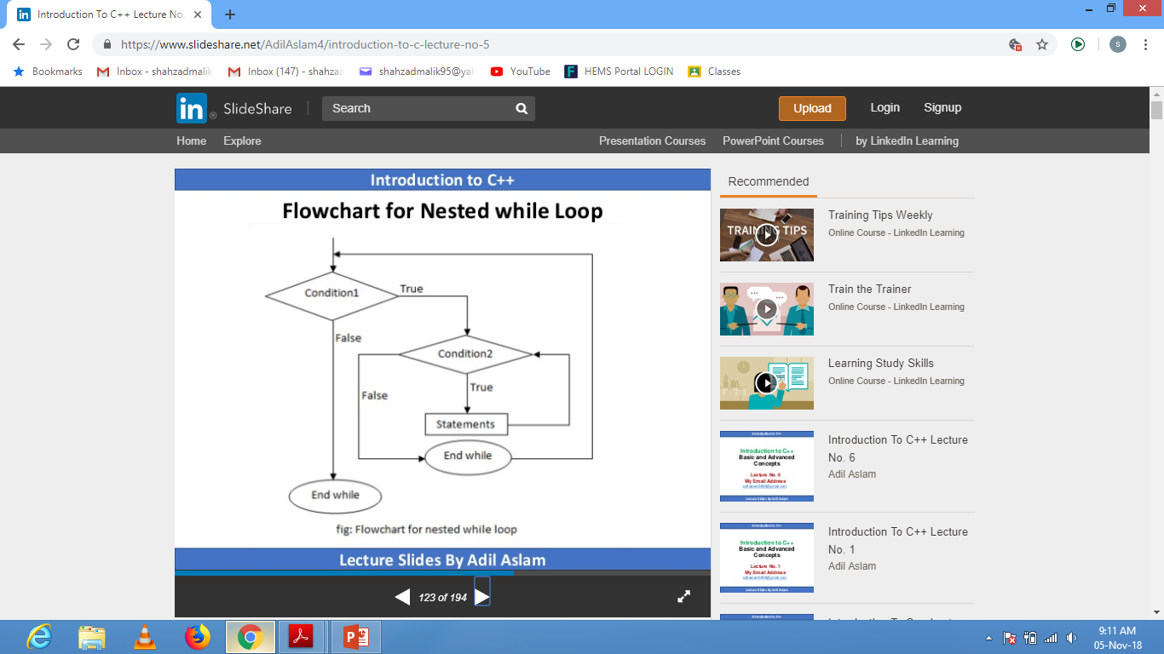

Slide 18
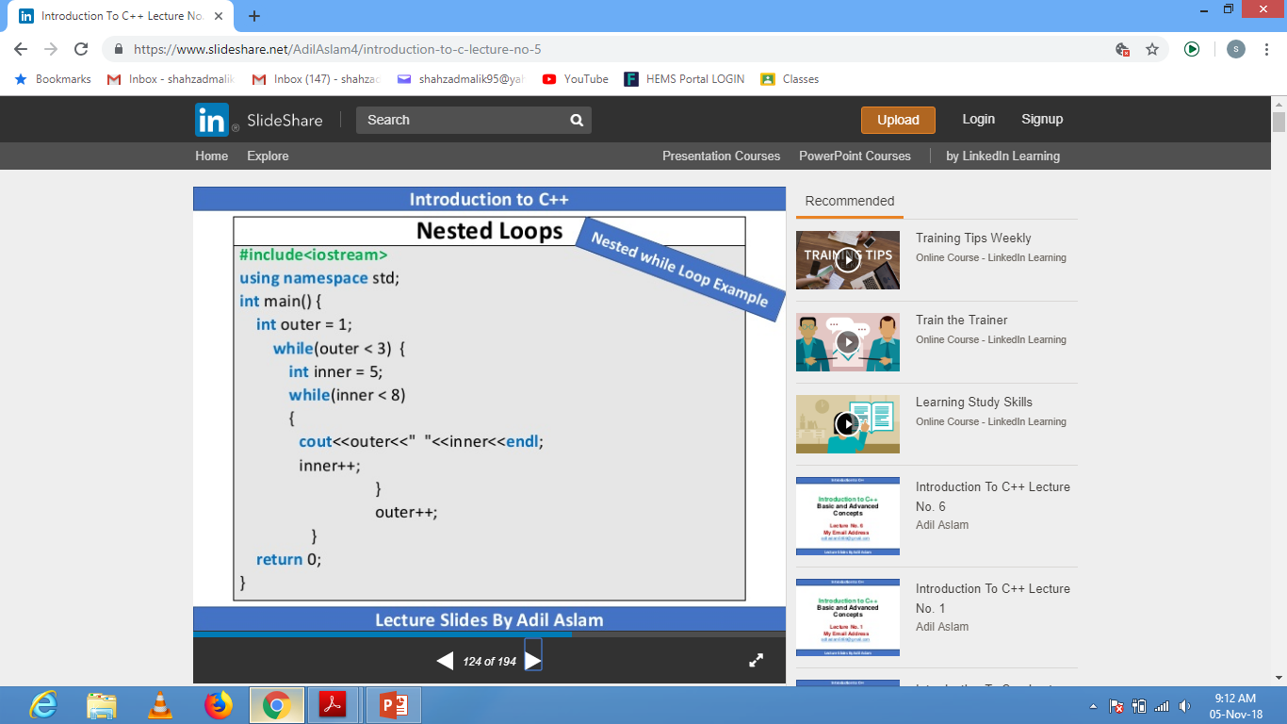

Slide 19
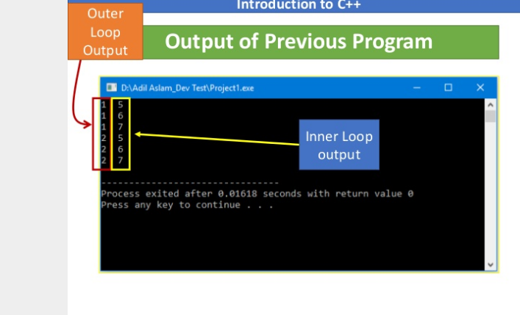

Slide 20
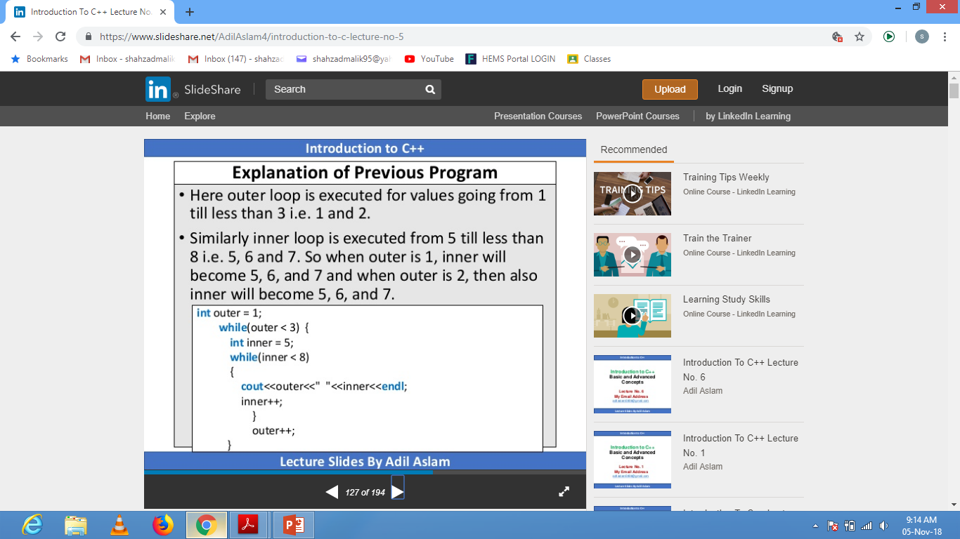

Slide 21
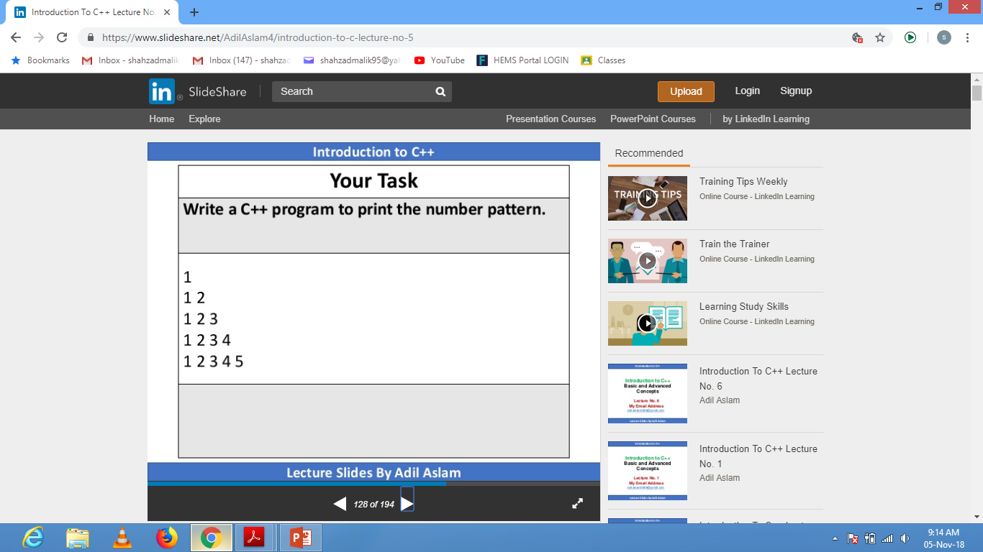

Slide 22
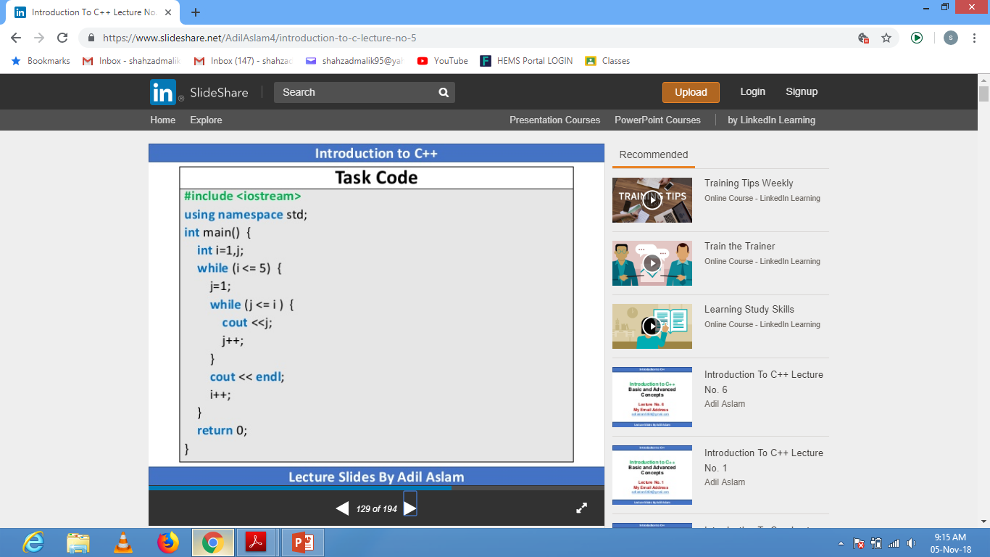

Slide 23
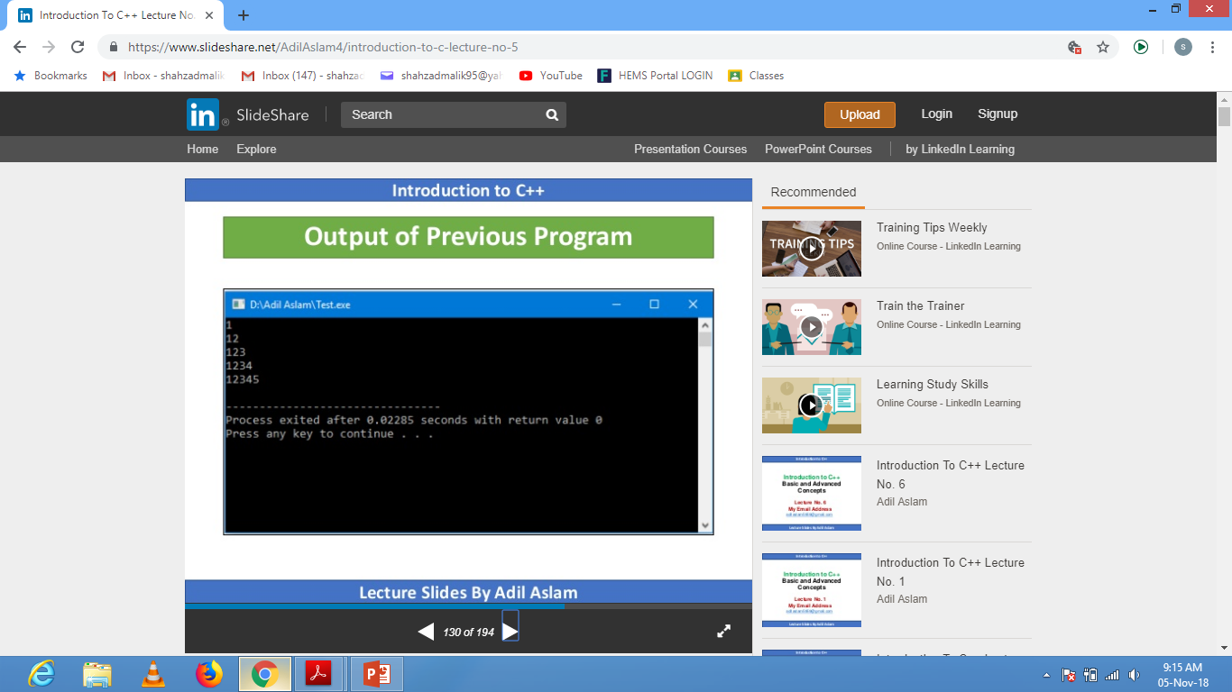

Slide 24
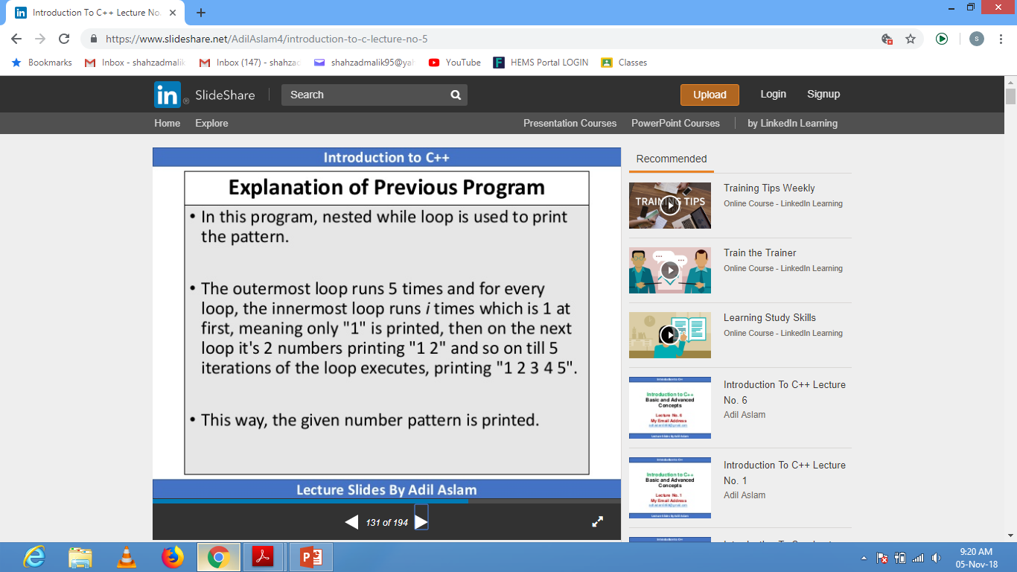

Slide 25
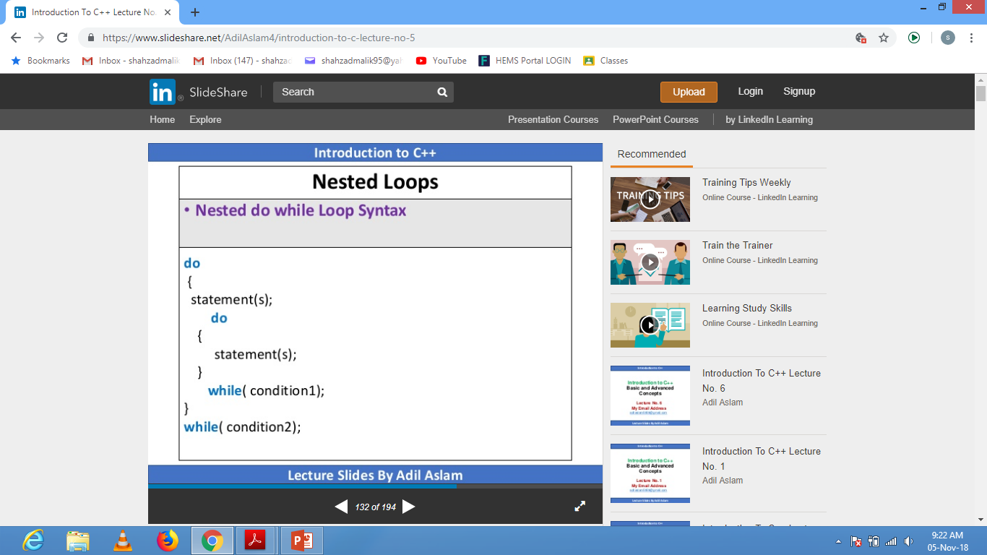

Slide 26
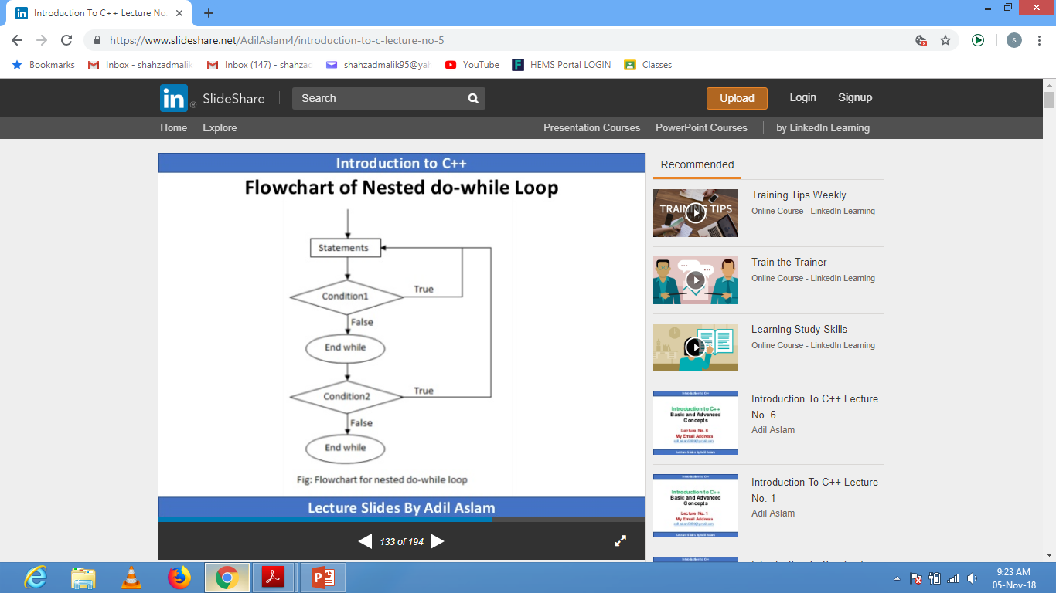

Slide 27
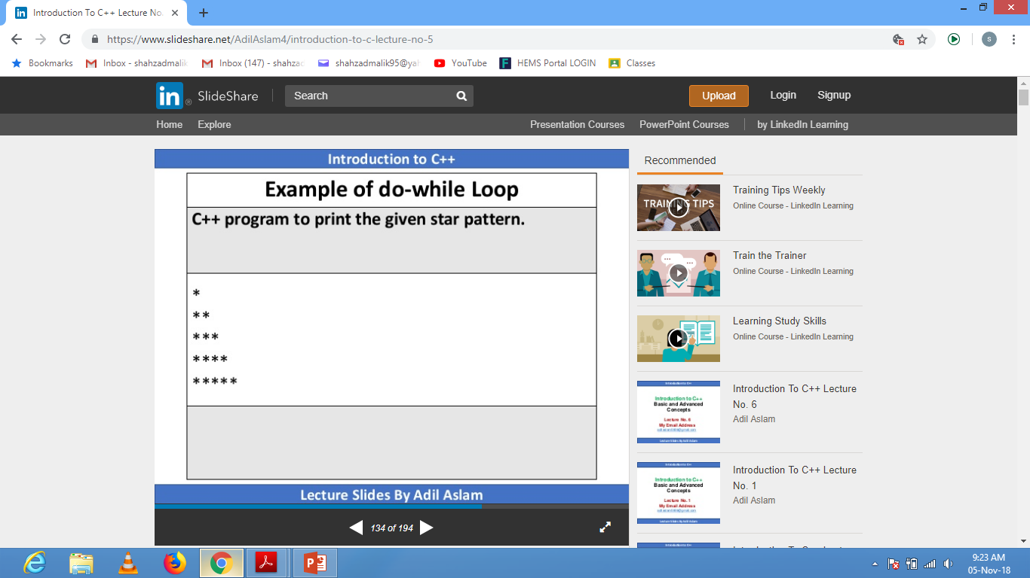
Your Assignment here

Slide 28
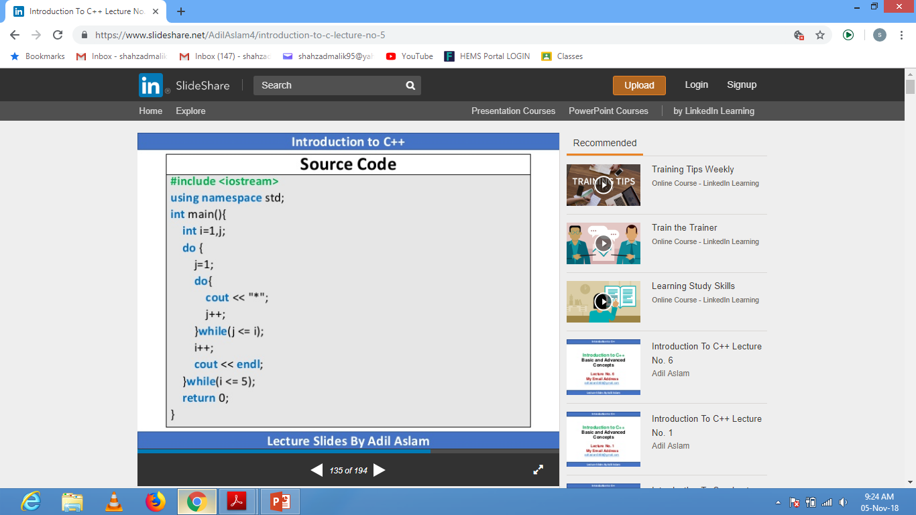

Slide 29
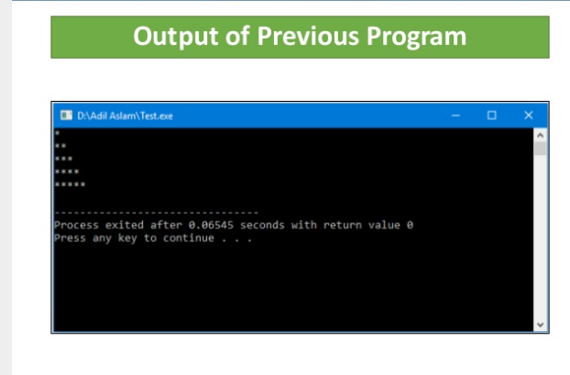

Slide 30


Slide 31
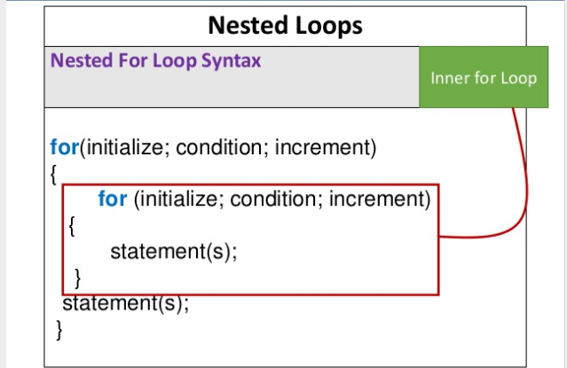

Slide 32
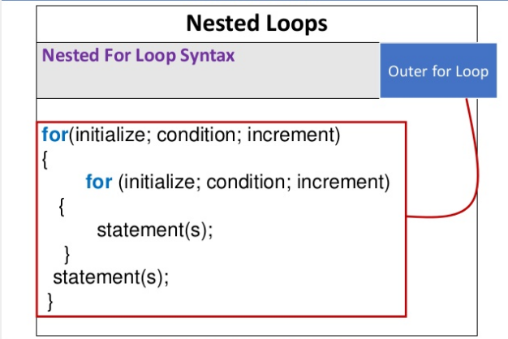

Slide 33
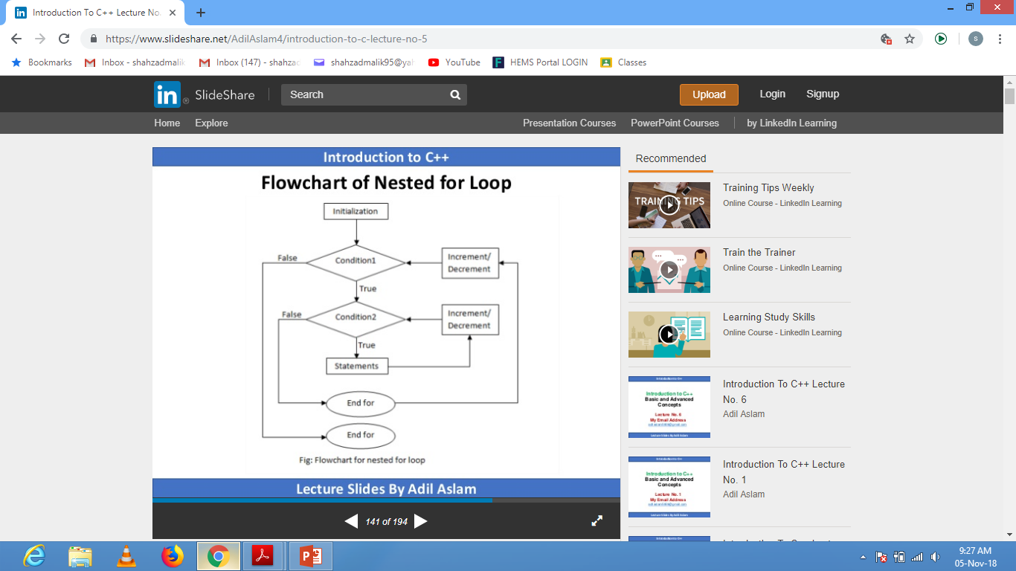

Slide 34
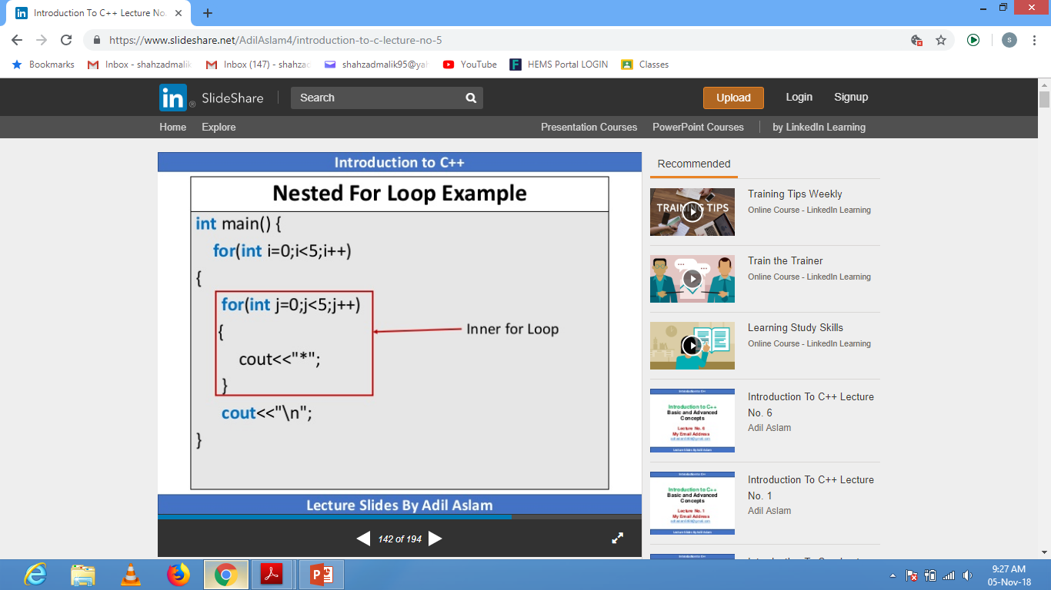

Slide 35
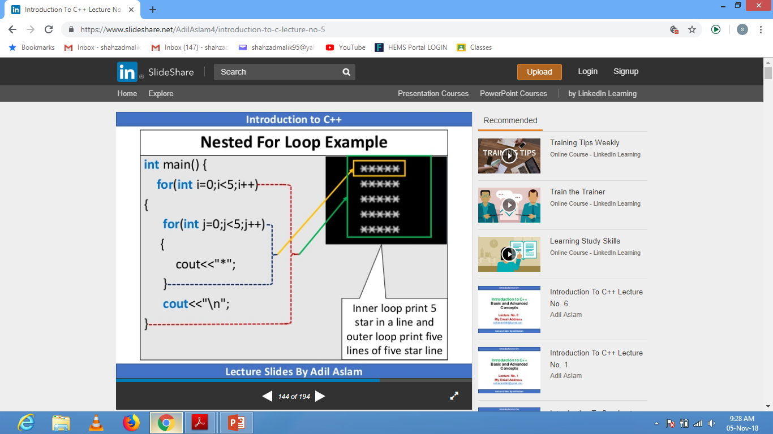

Slide 36
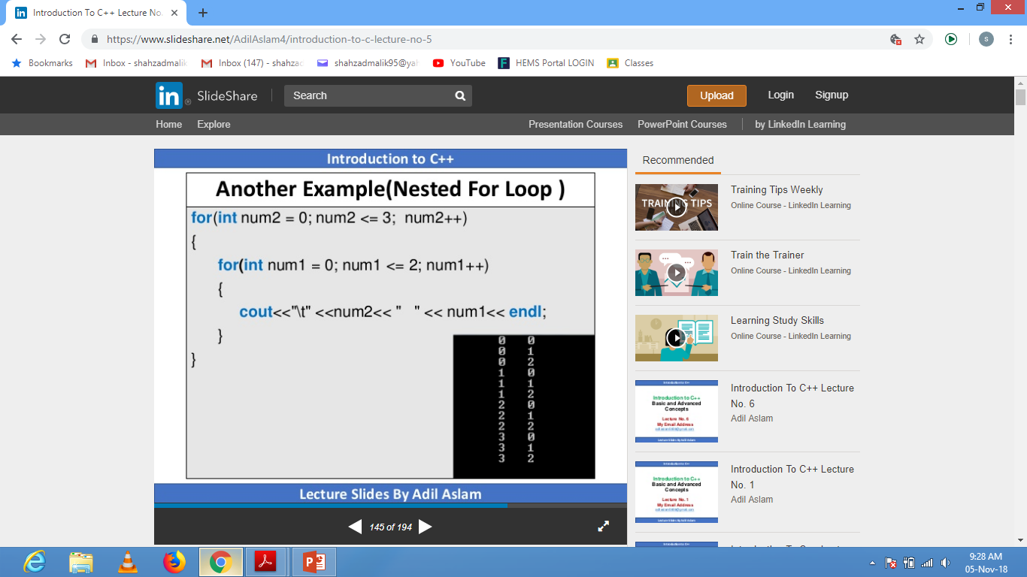

Slide 37
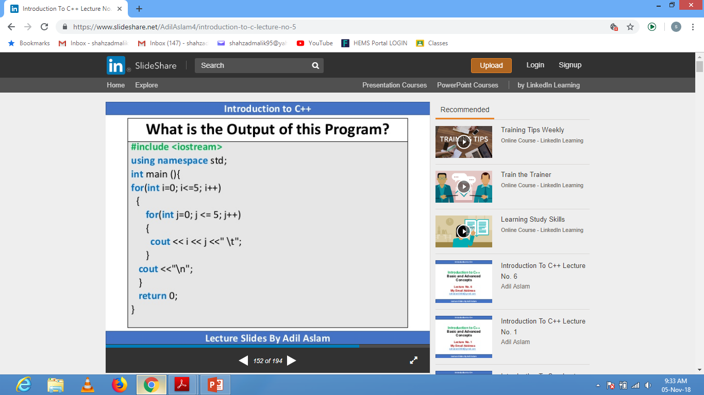

Slide 38
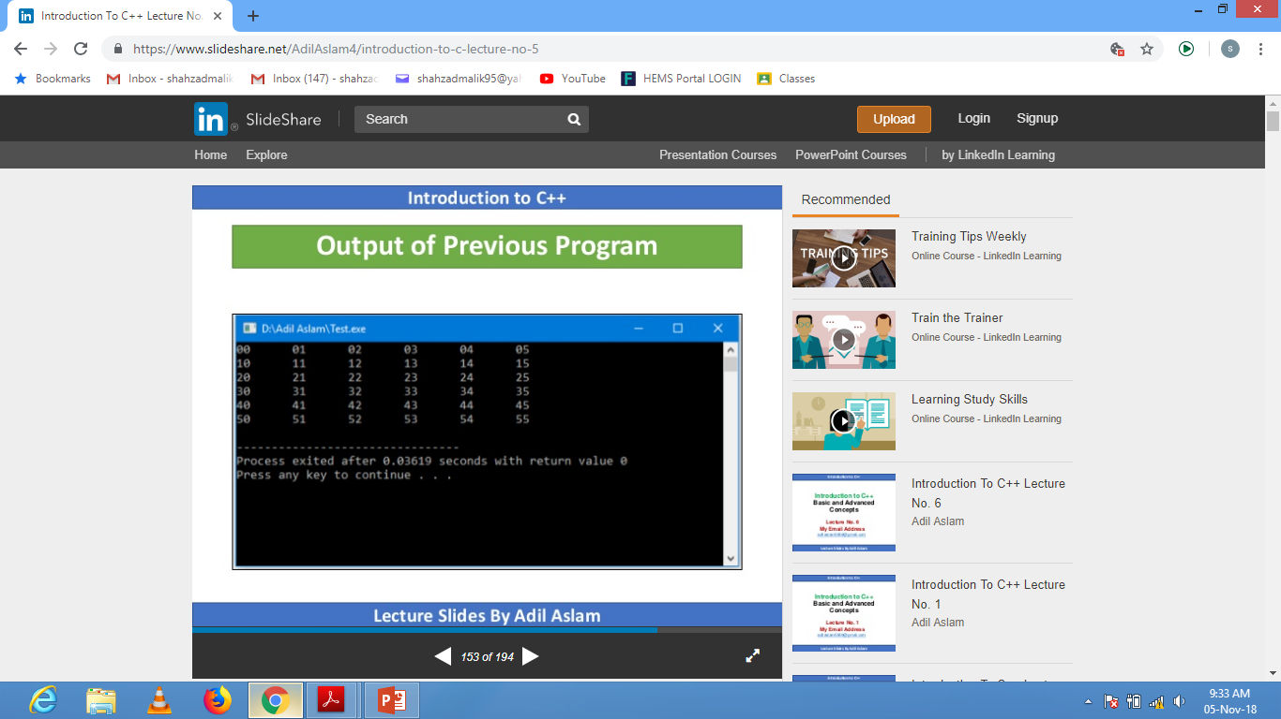

Slide 39
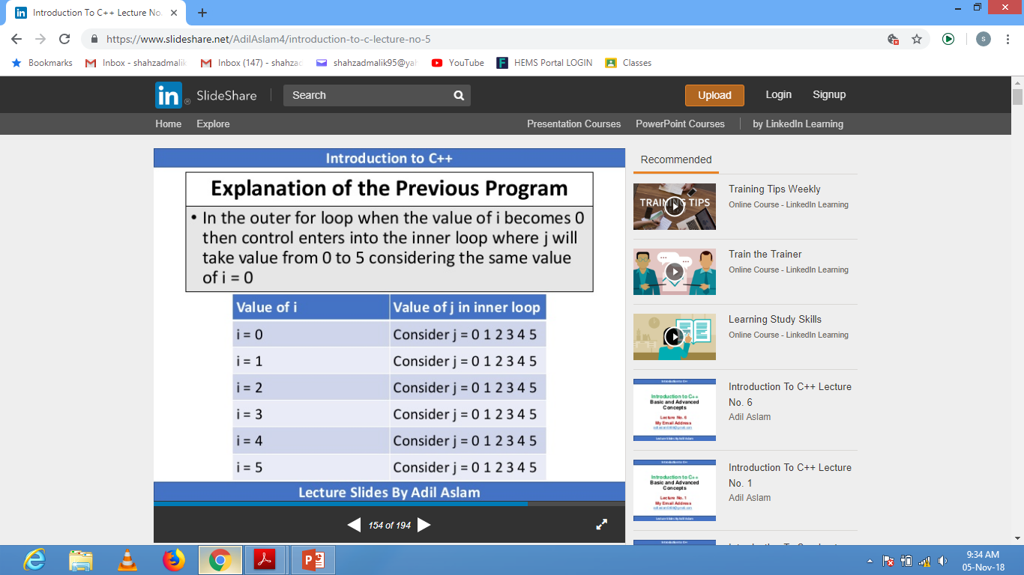

Slide 40
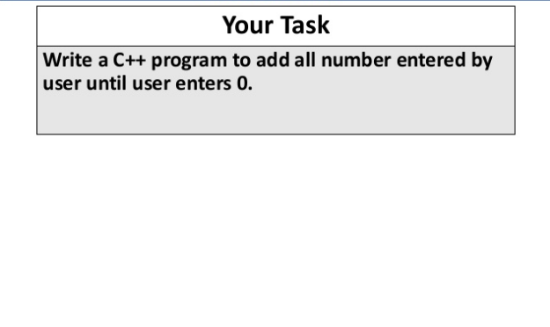

Slide 41


Slide 42
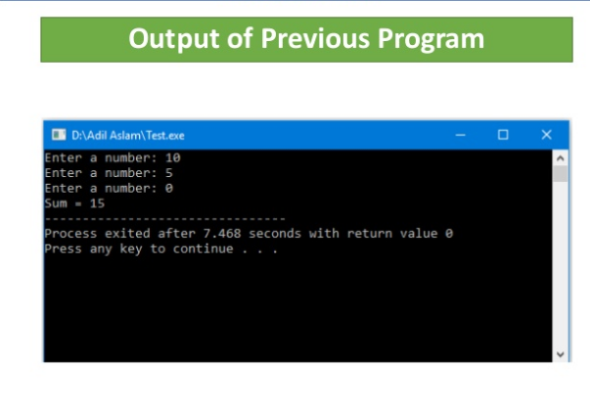

Slide 43
Continue Statement
The continue statement breaks one iteration upon occurring of specified condition and further continues with the next iteration in the loop.
for (int i = 0; i < 10; i++) { if (i == 4) { continue; } cout << i << "\n"; }
Output:
0
1
2
3
5
6
7
8
9

Slide 44
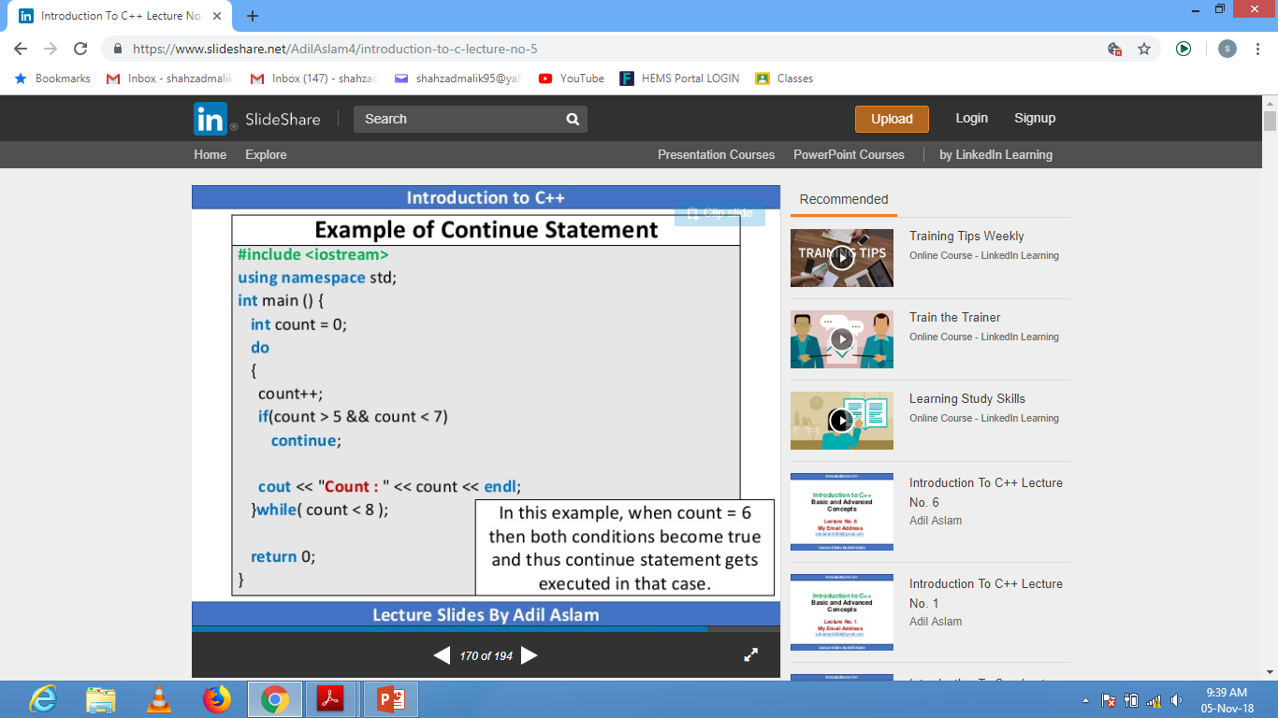
<=8);

Slide 45
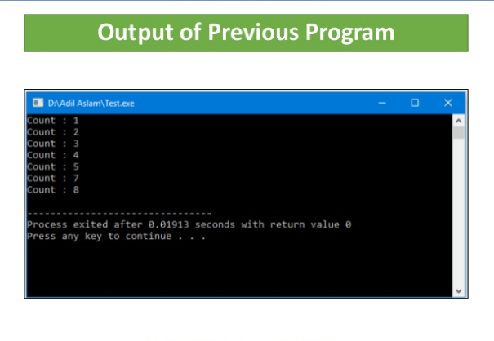

Slide 46

1

Slide 47
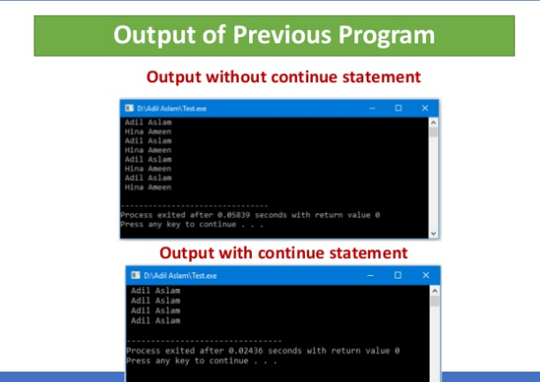

Slide 48
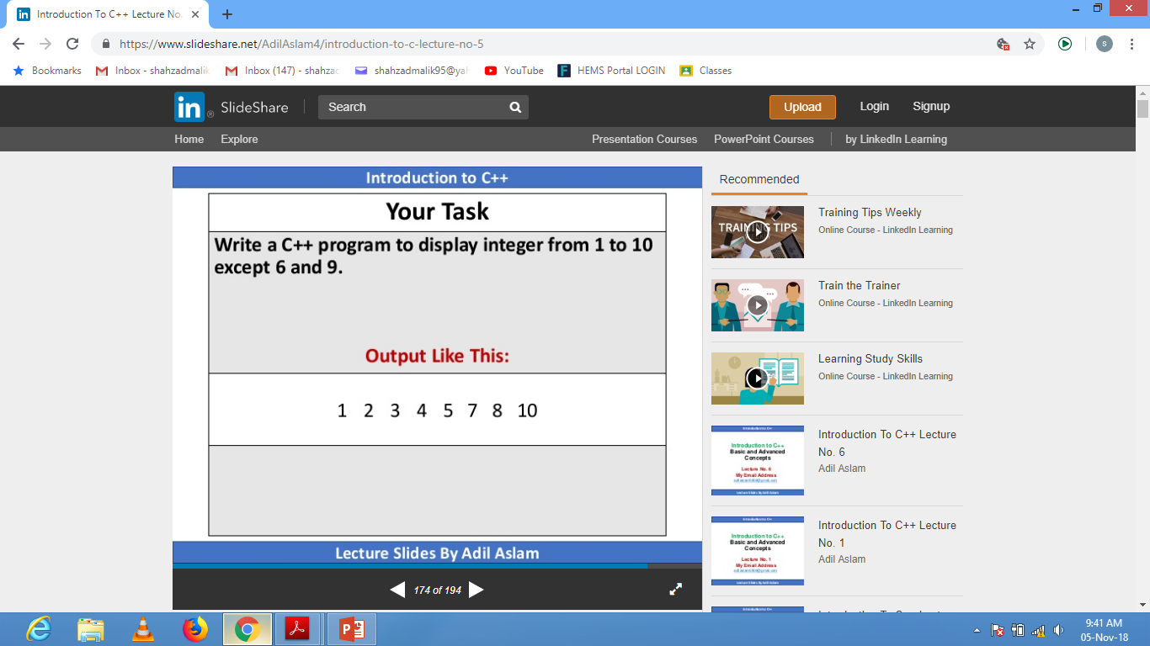

Slide 49


Slide 50
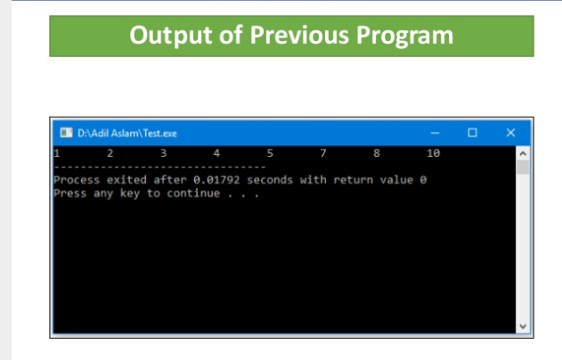

Slide 51
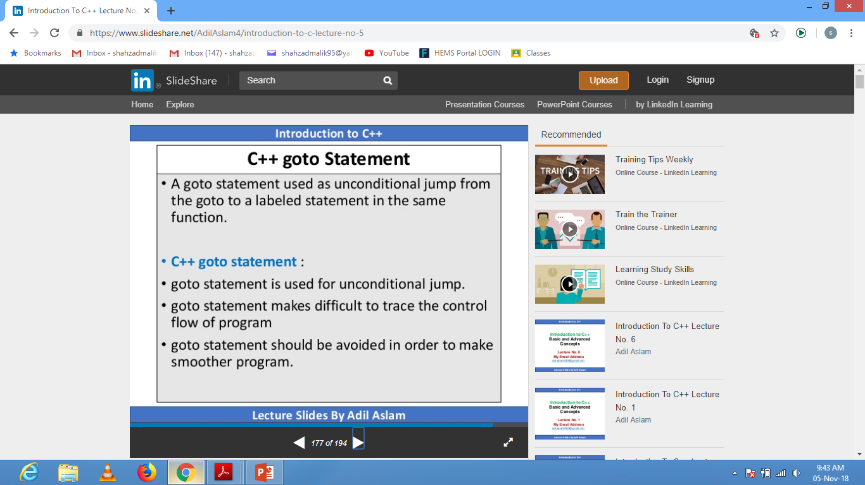

Slide 52
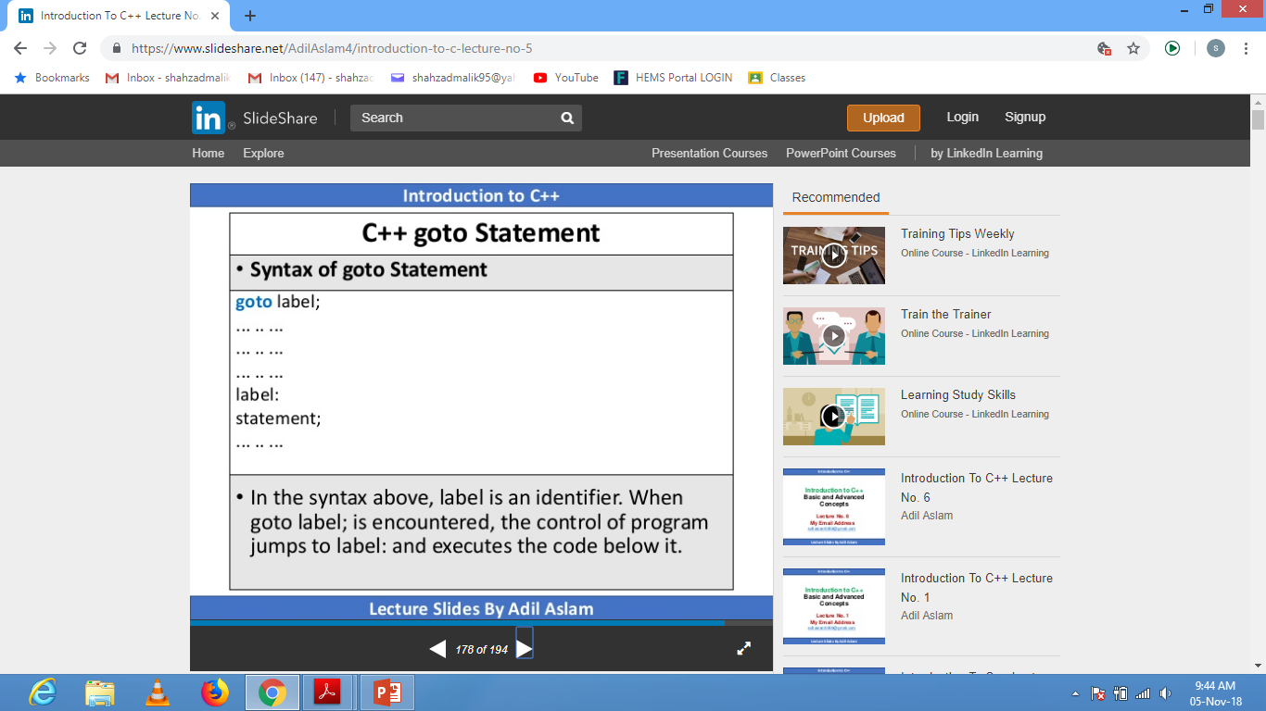

Slide 53
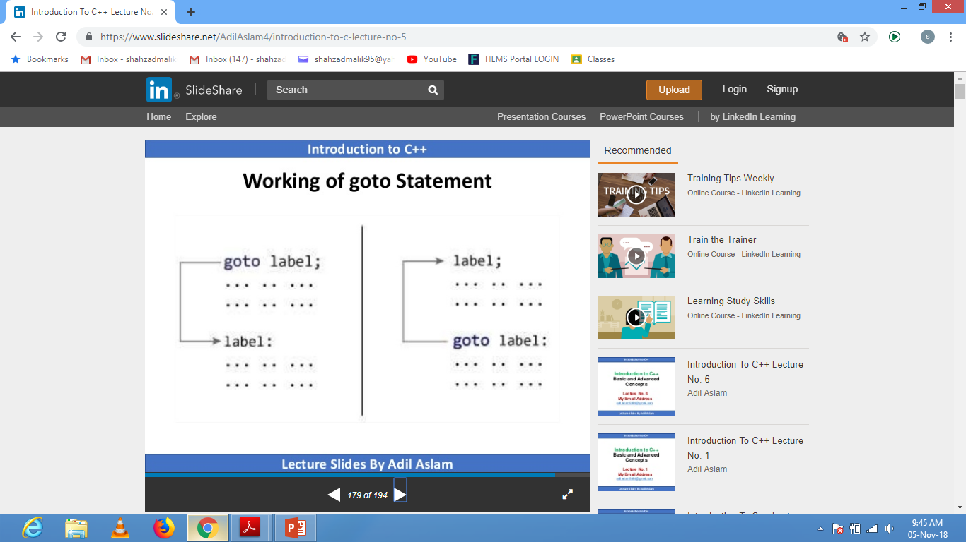

Slide 54
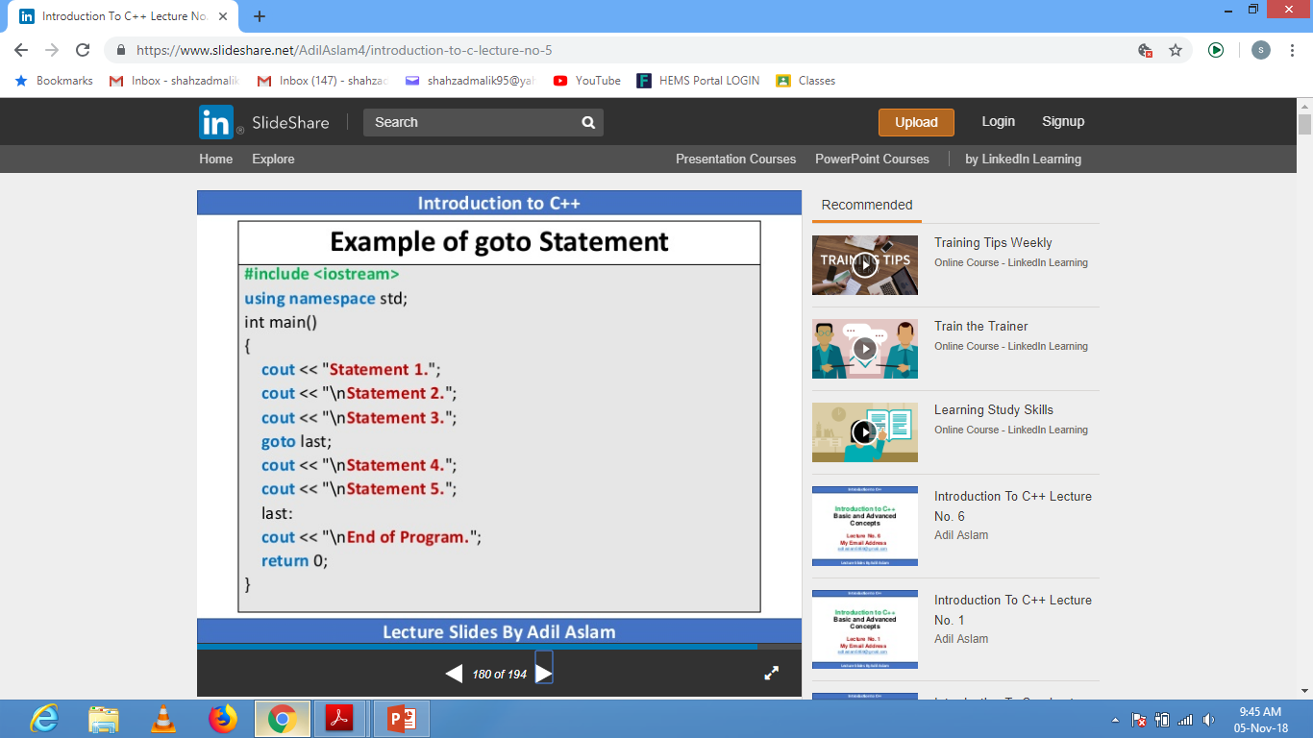

Slide 55
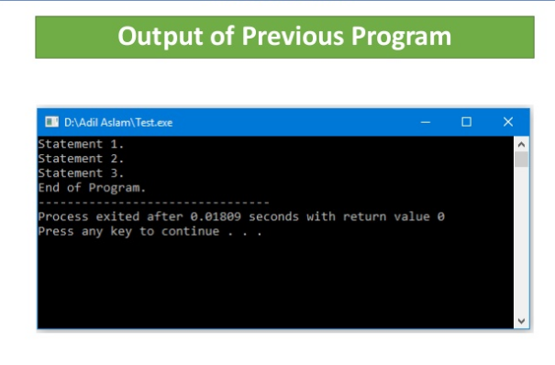

Slide 56
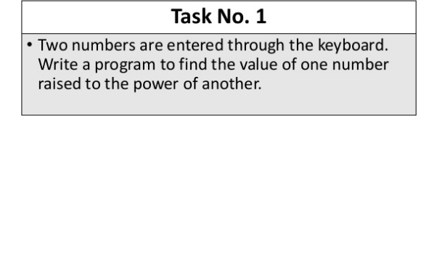

Slide 57
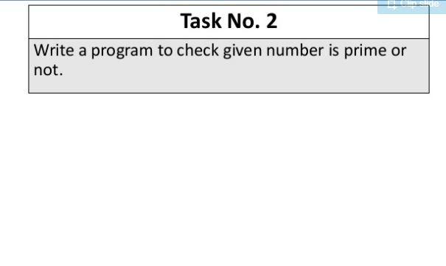

Slide 58
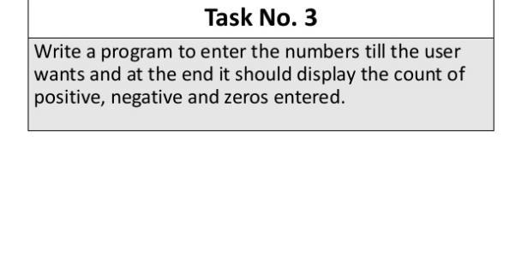

Slide 59
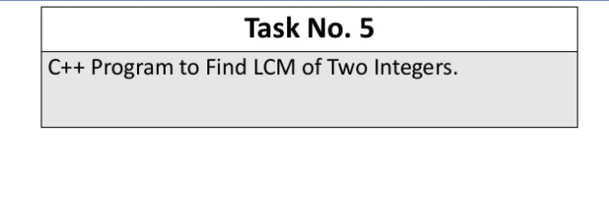
4

